Slide 1
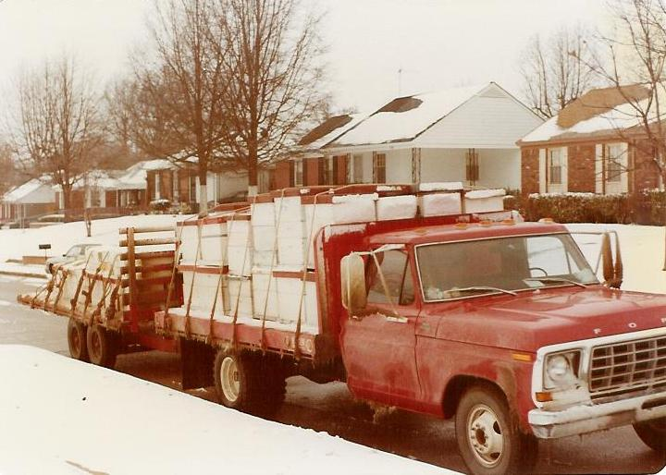
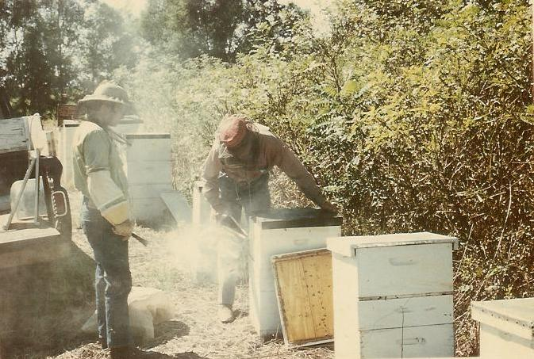
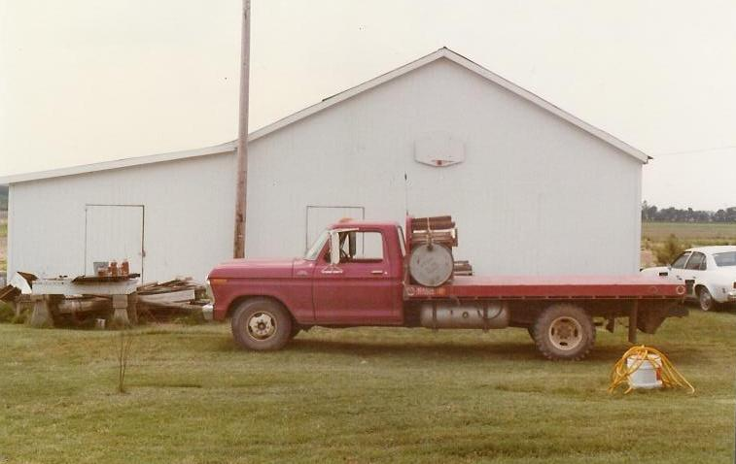
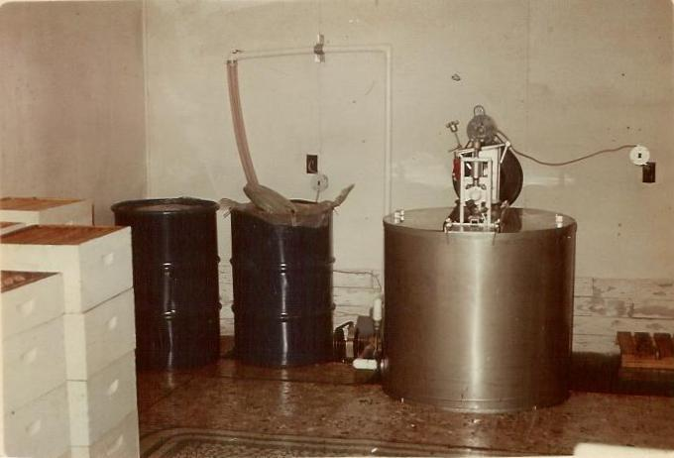
Beekeeping and Agriculture: A Beekeepers Perspective
Steven Coy
Coy’s Honey Farm Inc.
Jonesboro, AR & Perkinston ,MS

Slide 2
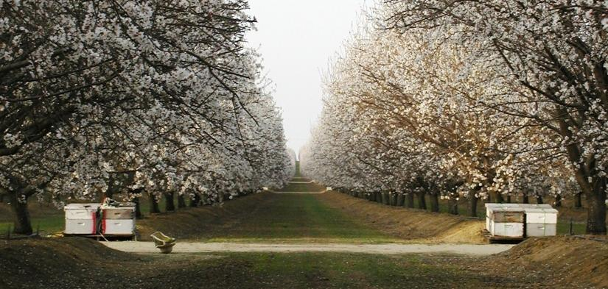
US Beekeeping exists primarily to meet the pollination need of agricultural crops
Approximately ½ of all commercially managed colonies are in California Almonds
60% or more of a commercial beekeepers income is from pollination

Slide 3
Managed Bees contribute to 35% of global food production
More than 90 crops in US Pollinated by Honey Bees
Acerola |  | Broccoli |  | Coconut |  | Guava |  |  | Naranjillo |  | Safflower |  | Tung tree
Alfalfa |  | Brussels sprouts |  | Coffea spp. Coffea arabica, Coffea canephora |  | Hazelnut |  |  | Oil palm |  | Sainfoin |  | Turnip, Canola
Allspice |  | Bucket orchid |  | Cola nut |  | Hog plum |  |  | Okra |  | Sapodilla |  | Vanilla
Almond |  | Buckwheat |  | Coriander |  | Hyacinth bean |  |  | Onion |  | Scarlet runner bean |  | Vetch
Alsike clover |  | Cabbage |  | Cotton |  | Jack bean, Horse bean, Sword bean |  |  | Papaya |  | Service Tree |  | Walnut
American Pawpaw |  | Cactus, Prickly pear |  | Cowpea, Black-eyed pea, Blackeye bean |  | Jujube |  |  | Passion fruit. Maracuja |  | Sesame |  | Watermelon
Apple |  | Cantaloupe, Melon |  | Cranberry |  | Karite |  |  | Peach, Nectarine |  | Sour cherry |  | White clover
Apricot |  | Carambola, Starfruit |  | Crimson clover |  | Kiwifruit |  |  | Pear |  | Soybean
Arrowleaf clover |  | Caraway |  | Crownvetch |  | Lemon |  |  | Persimmon |  | Squash (plant), Pumpkin, Gourd, Marrow, Zuchini
Atemoya, Cherimoya, Custard apple |  | Cardamom |  | Cucumber |  | Lima bean, Kidney bean, Haricot bean, Adzuki bean, Mungo bean, String bean, Green bean |  |  | Pigeon pea, Cajan pea, Congo bean |  | Stanhopea
Avocado |  | Carrot |  | Durian |  | Lime |  |  | Plum, Greengage, Mirabelle, Sloe |  | Star apple, Cainito
Azarole |  | Cashew |  | Eggplant |  | Longan |  |  | Pomegranate |  | Strawberry
Beet |  | Cauliflower |  | Elderberry |  | Loquat |  |  | Quince |  | Strawberry tree
Black currant, Red currant |  | Celery |  | Feijoa |  | Lupine |  |  | Rambutan |  | Sunflower
Blackberry |  | Chestnut |  | Fennel |  | Lychee |  |  | Rapeseed |  | Sweet Cherry
Blueberry |  | Chilli pepper, Red pepper, Bell pepper, Green pepper |  | Fig |  | Macadamia |  |  | Raspberry |  | Tamarind
Boysenberry |  | Chinese cabbage |  | Flax |  | Mammee apple |  |  | Red clover |  | Tangelo
Brazil nut |  | Clover (not all species) |  | Grape |  | Mango |  |  | Rose hips, Dogroses |  | Tangerine
Broad bean |  | Cocoa |  | Guar bean, Goa bean |  | Mustard |  |  | Rowanberry |  | Tomato

Slide 4
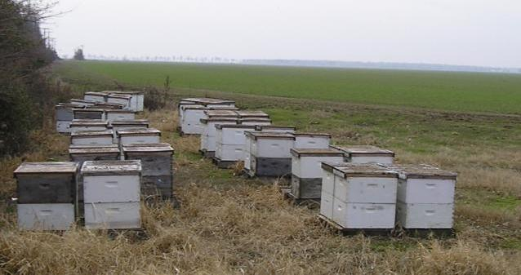
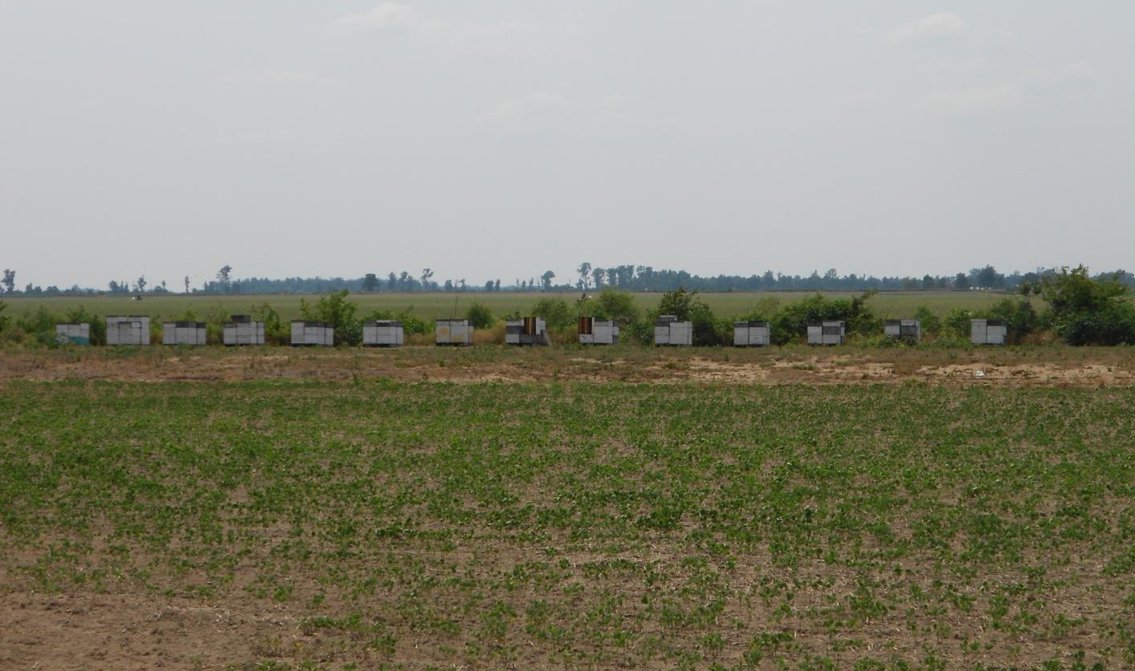
Managed Honey Bees Must Reside Adjacent to Production Agriculture.

Slide 5
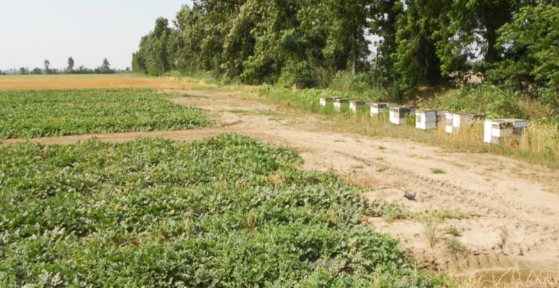
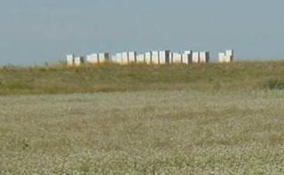
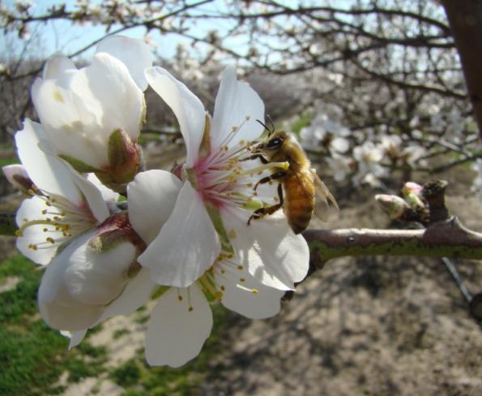
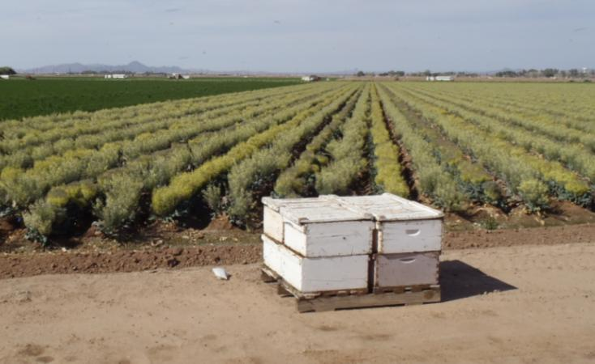
We are part of Agriculture production
Notes:
Beekeeping which includes honey production as well as pollination is part of Agriculture.
Watermelons in SE Missouri
Buckwheat in N Dakota
Broccoli in AZ
Winter wheat which will be followed by soybeans in NE Arkansas

Slide 6
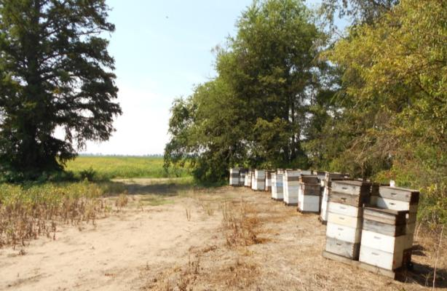
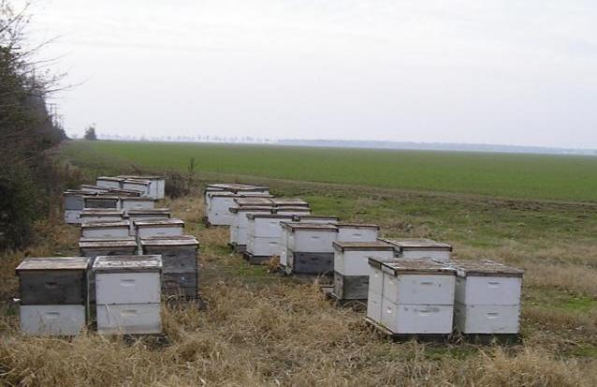
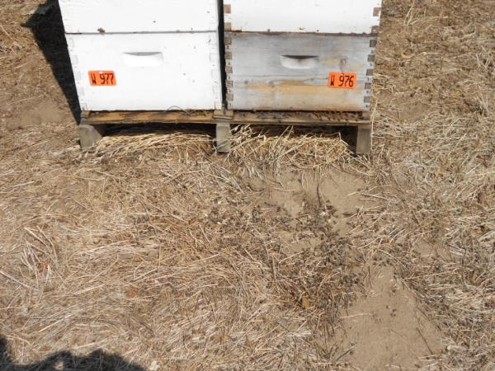
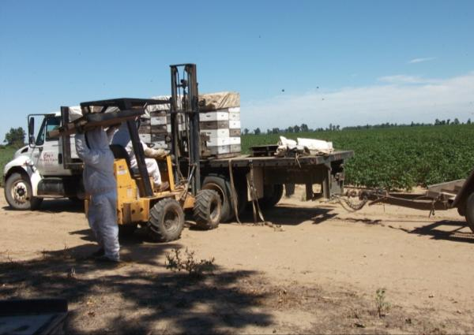
We Farm Where We Live

Slide 7
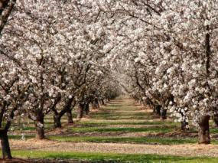
Coy’s Honey Farm’s Annual Migration
January
5000
2000
July
3000
November
2000
May
8000
March
3000
Notes:
We operate in 3 locations. NE Arkansas is home, this is where the extracting facilities are located.
South Mississippi is where I live and where we make our splits and some honey.
And finally we have several locations in the Mississippi Delta.
In November we move about 1800 hives from the Delta to S. MS. We use these hives to make our splits.
In January we send bees from NE Arkansas to Almonds.
When the bees are released from the Almonds most go the S. MS to make honey and the rest go to NE Arkansas.
After we have backed checked the splits we move then to the Delta and NE Arkansas in May.
We pull honey in Junes and in July we move all the bees to NE Arkansas so they can make more honey.

Slide 8
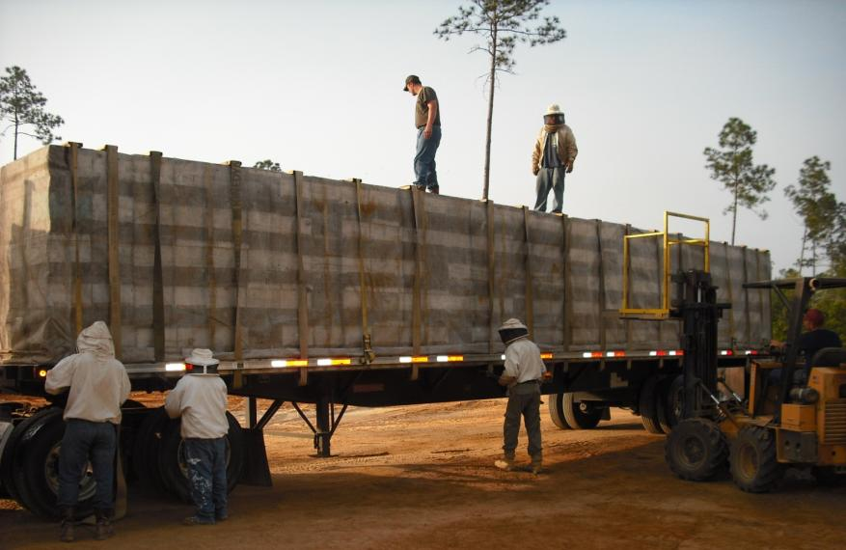
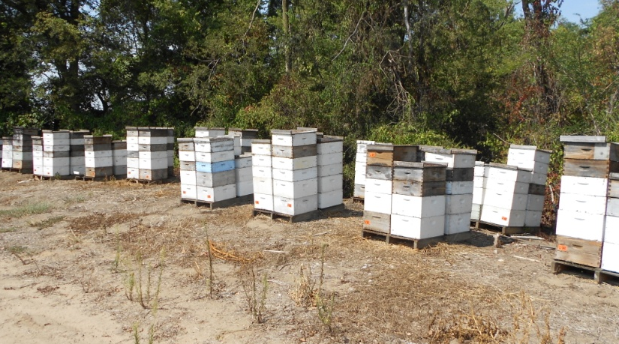
Pollinators are an important part of the ecosystem and should be protected from harm caused by pesticide use.
Moving bees to facilitate pesticide applications of crops and weeds in bloom is not a sustainable management model, financially or ecologicaly.
Where can we go where a pest insect does not exist?
When one producer in an area sprays they all spray.
The Label is the Law

Slide 9
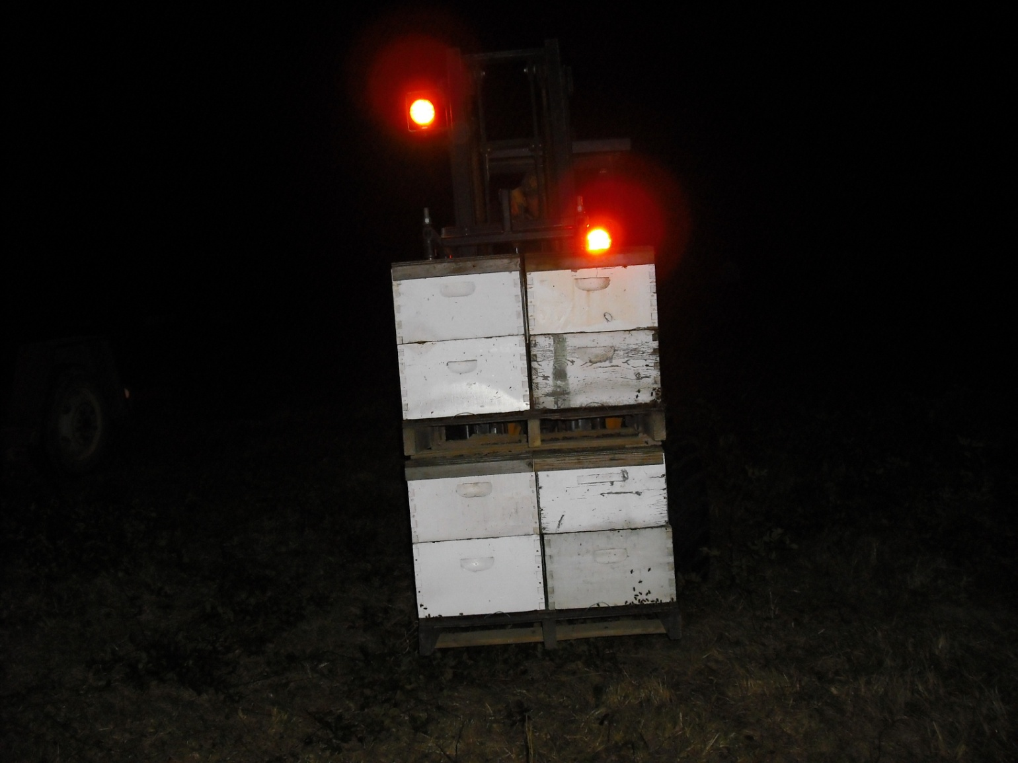
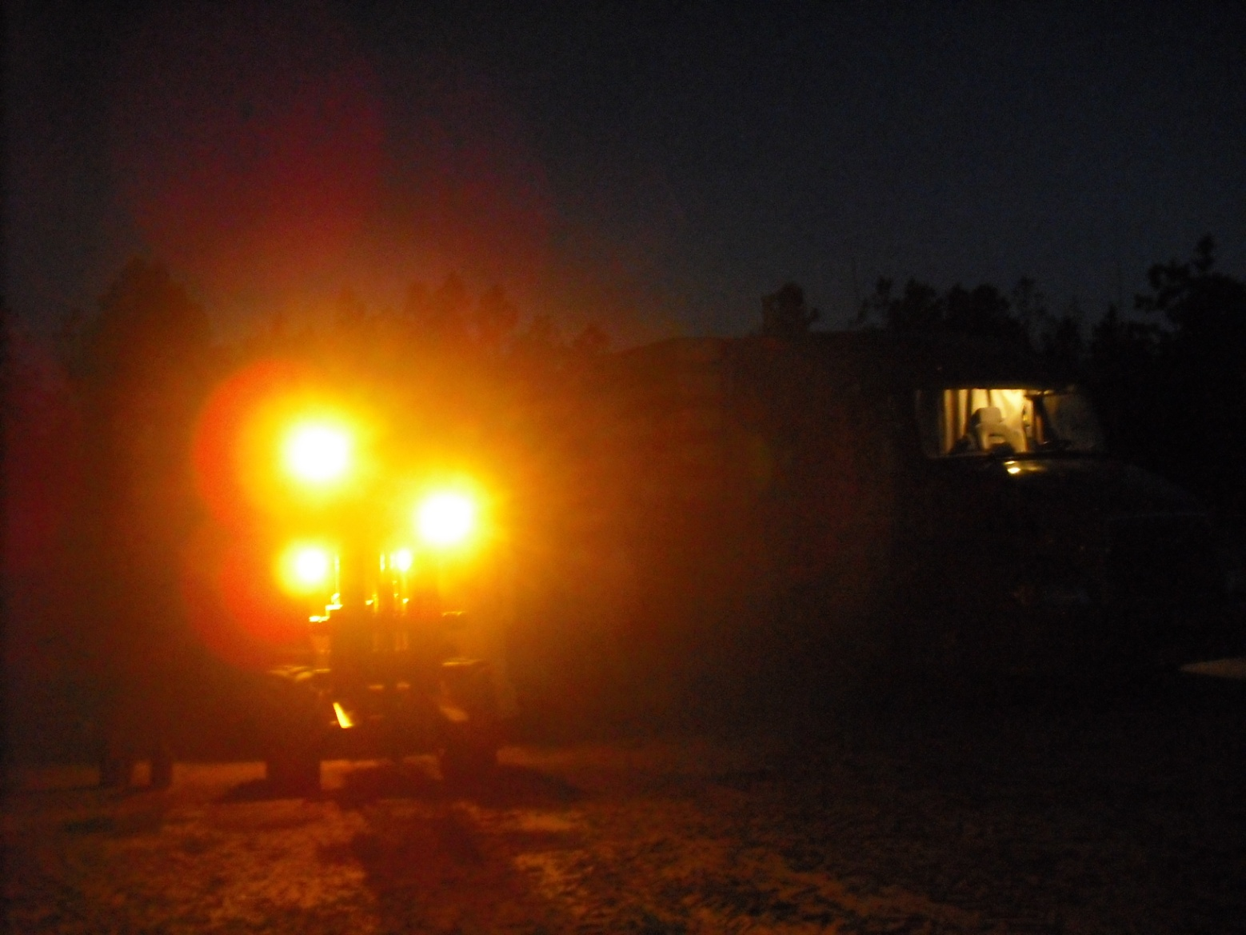
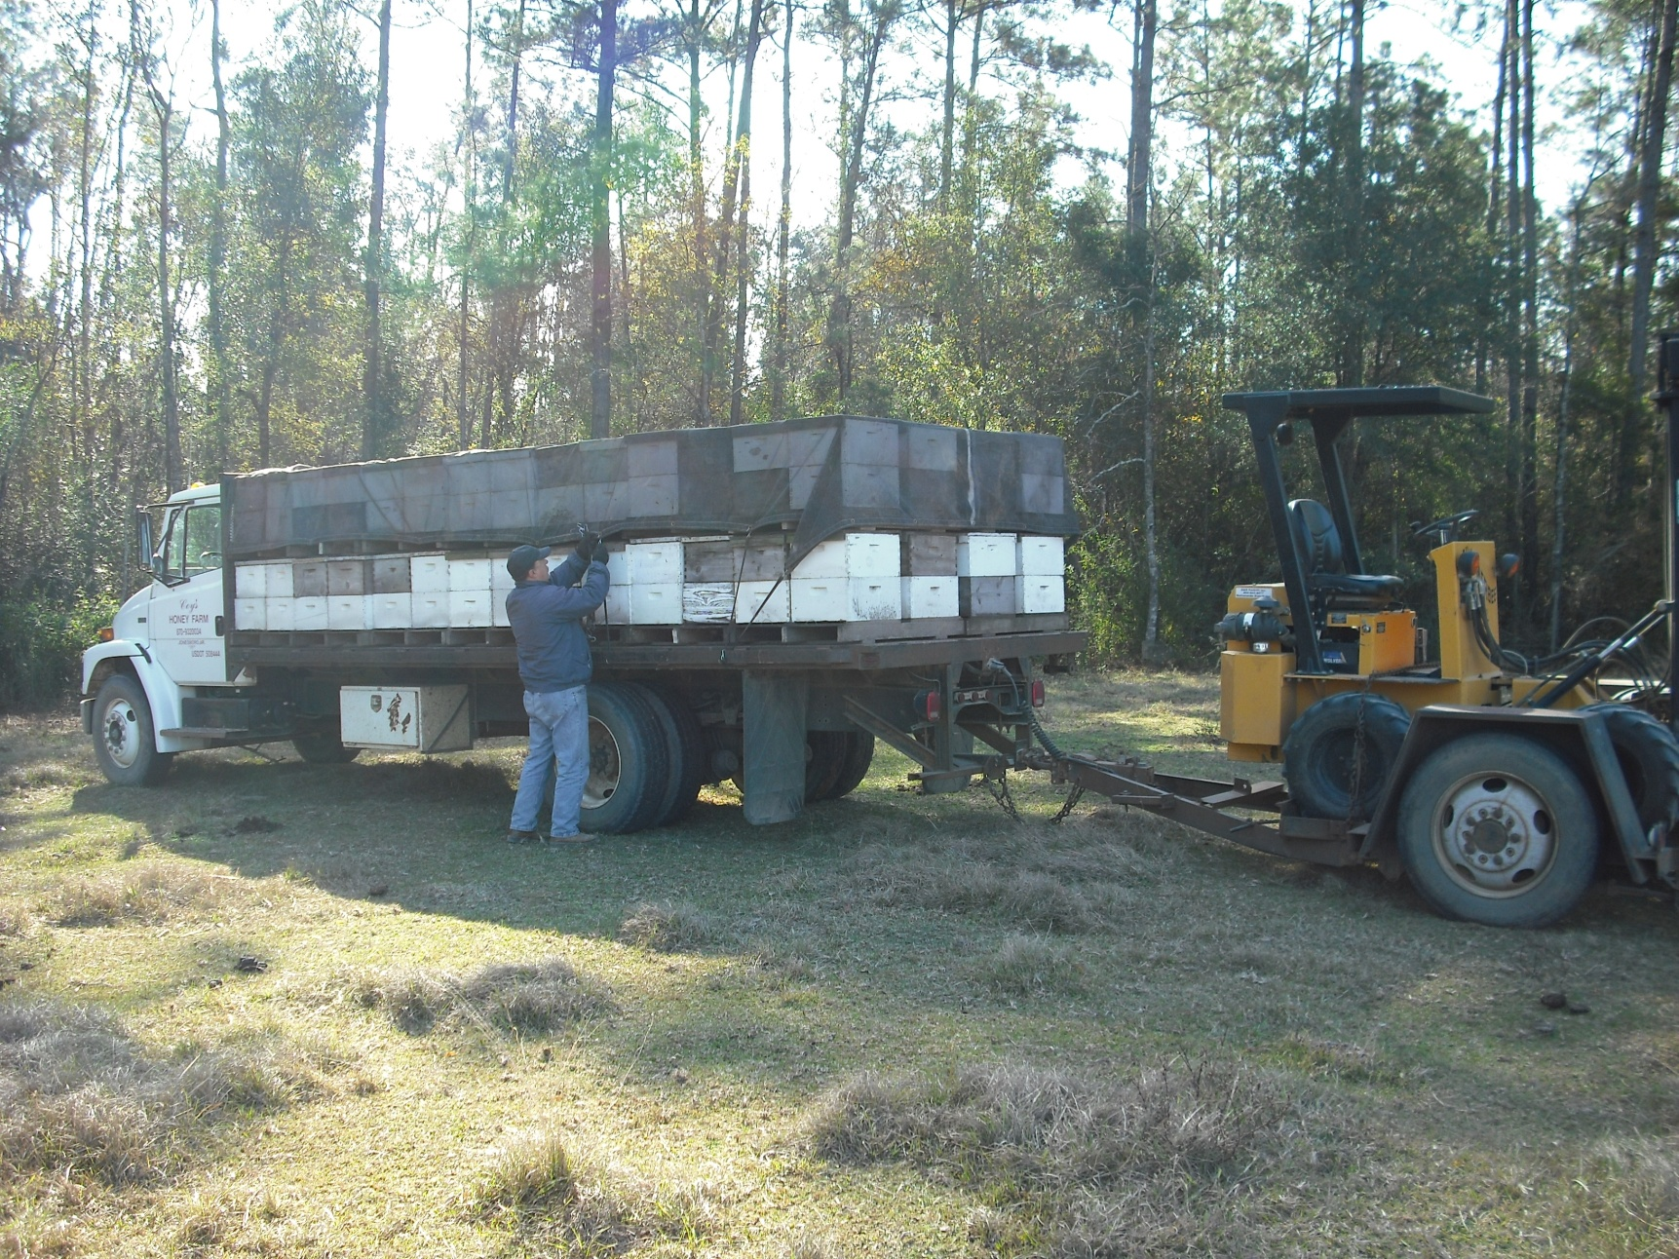
Moving Bees

Slide 10
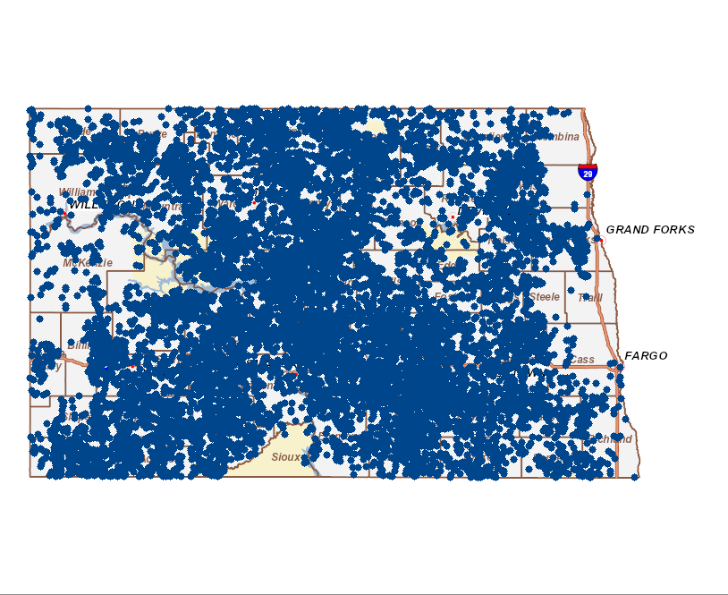
Bee Locations in North Dakota

Slide 11
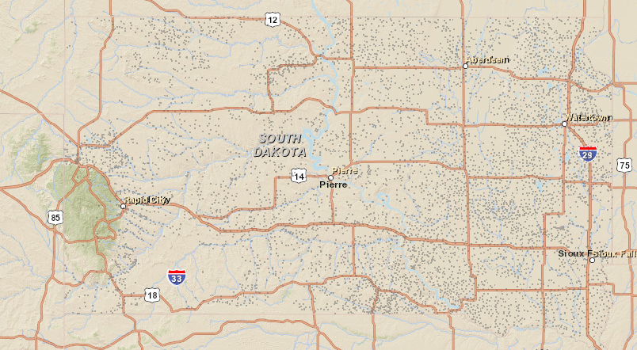
Bee Locations in South Dakota
1 million colonies spend the summer in
N. Dakota, S. Dakota, Minnesota and Wisconsin

Slide 12
Agriculture Producers are the Original Environmental Stewards
Beekeepers are an important part of Agriculture
We are each other’s neighbor and everyone should be a good steward of the environment.

Slide 13
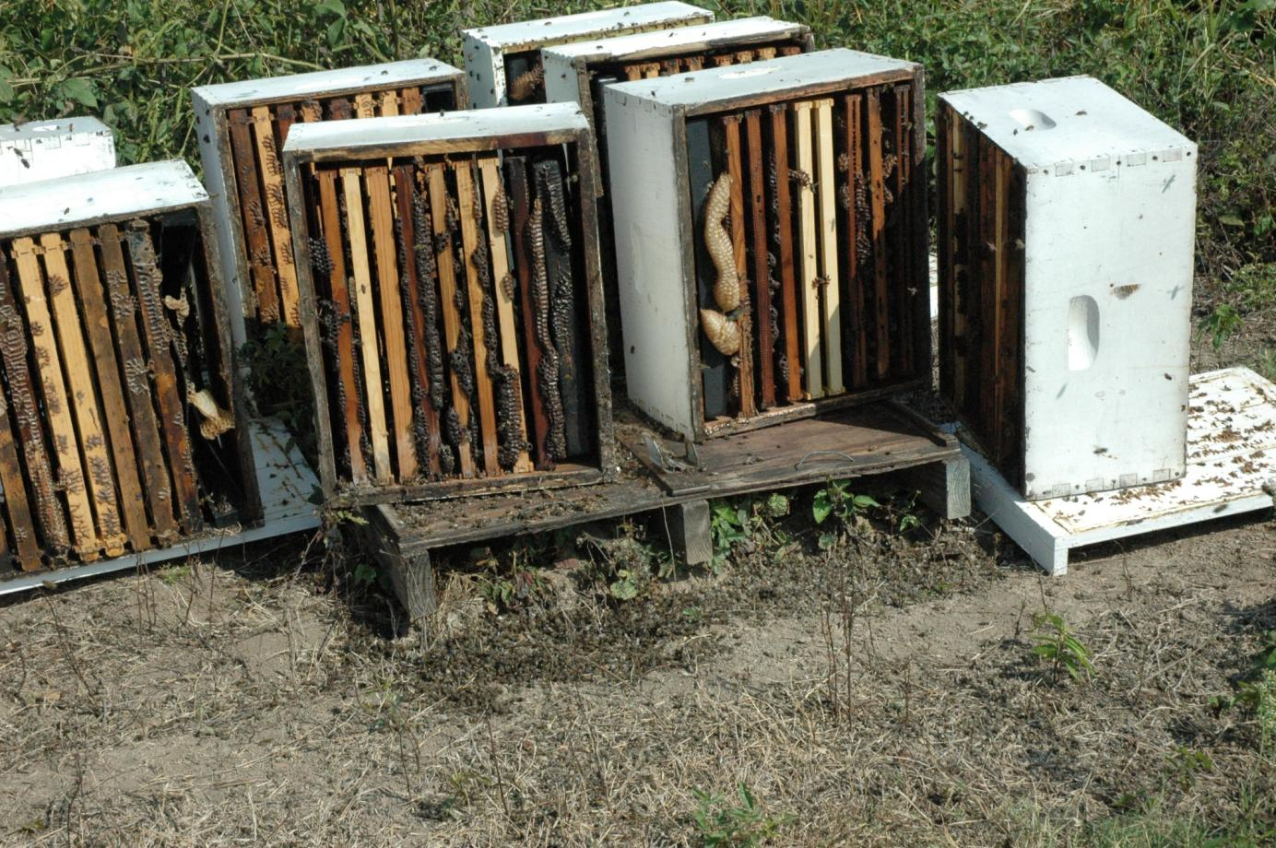
This Is Not Good Stewardship

Slide 14
Rabobank Report The Plight of the Honey Bee 2011
A long-term trend of a declining number of bee colonies per hectare
Global production of pollination-requiring crops is growing faster than the amount of bee colonies. Consequently, the amount of bee colonies per hectare planted with these crops is in decline.
The United States is a key risk region as the number of bee colonies per hectare of pollination-requiring crops has declined by 90% in the past 50 years. In Europe, the decline of colonies per hectare requiring pollination is estimated at 20%-25%.

Slide 15
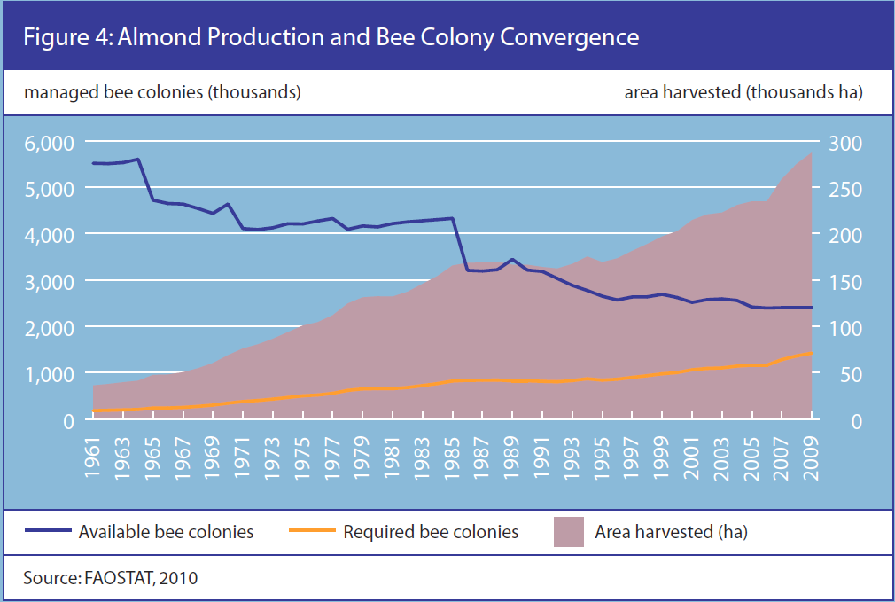

Slide 16
Conclusions of Rabobank Article
There must be cooperation between the academic world, governmental bodies apiarists and companies directly dependent on pollination.
Biodiversity in agricultural areas should be increased to provide nutritional variety for bees
While pesticide use cannot be eliminated, application should take place in cooperation with beekeepers
Avoid pesticide use when bees are foraging (during daylight hours).
Pollination should not be considered as a production factor which should be taken of granted.
Food & Agribusiness Research and Advisory
www.rabobank.com/far

Slide 17
My Perspective
Last fall was just preparation for this spring
Timing of mite treatments
Need for supplemental feeding
Late splits equals a short crop
Window of nectar availability
3 requirements for successful beekeeping (Industry)
Good bees
Good locations
Good weather

Slide 18
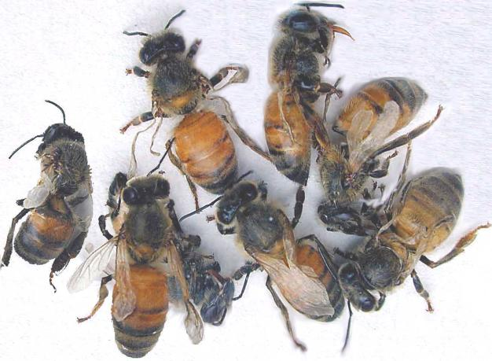
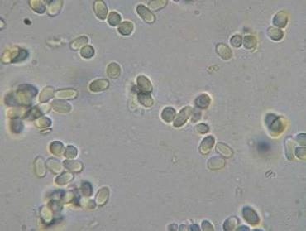
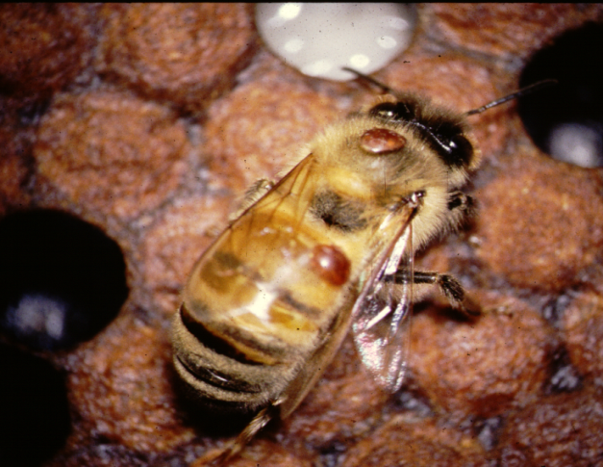
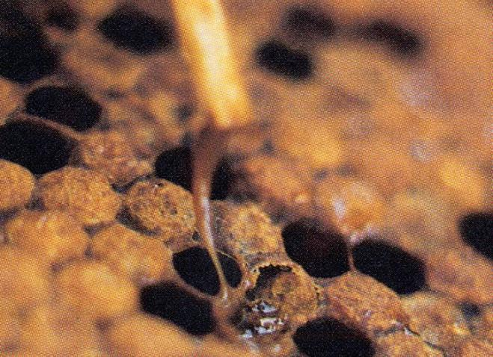
Honey Bee Diseases and Pests
Virus
Nosema a gut parasite
Parasitic Varroa mites
American foulbrood disease

Slide 20
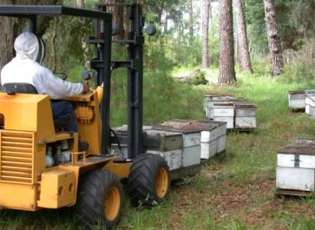
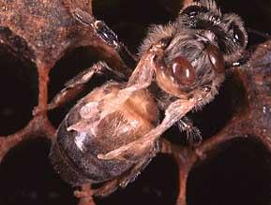
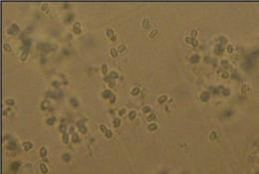
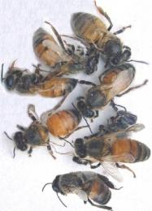
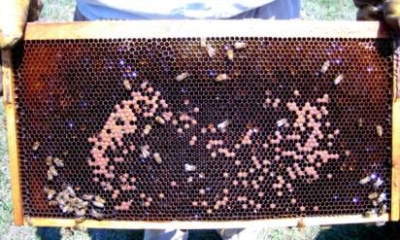
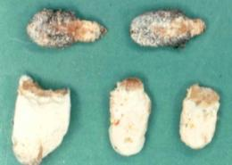
Working Hypothesis
Primary Stress
Varroa Mites
Management
Nutrition
Pesticides
Viruses
Secondary Pathogens
Nosema
Fungi

Slide 21
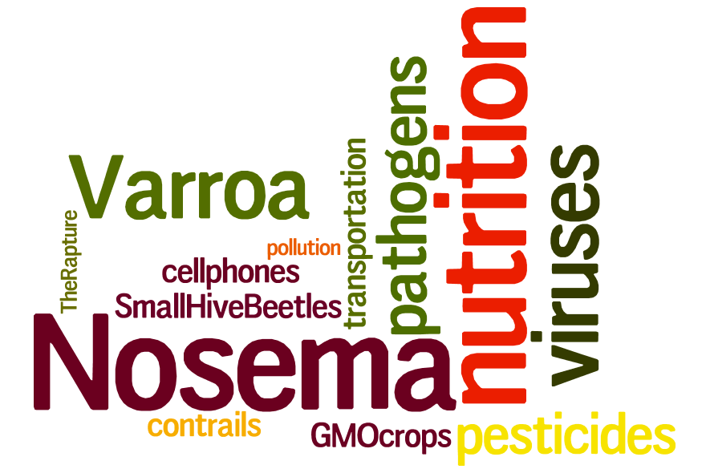

Slide 23
What Creates this Result ?
vanEngelsdorp et al. 2007, 2008, 2009 and 2011

Slide 24
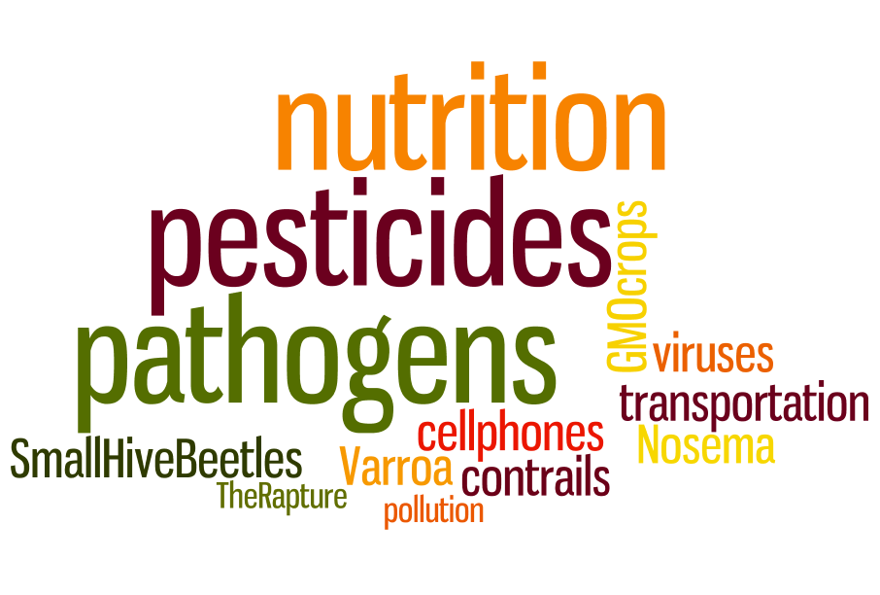

Slide 25
Why the losses this year?

Slide 26
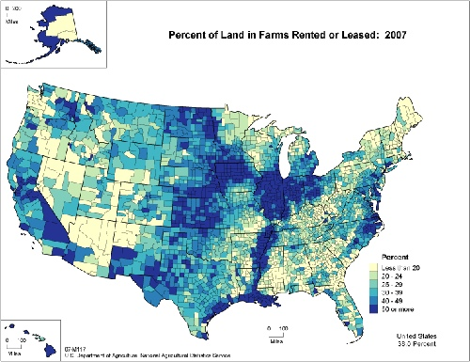

Slide 27
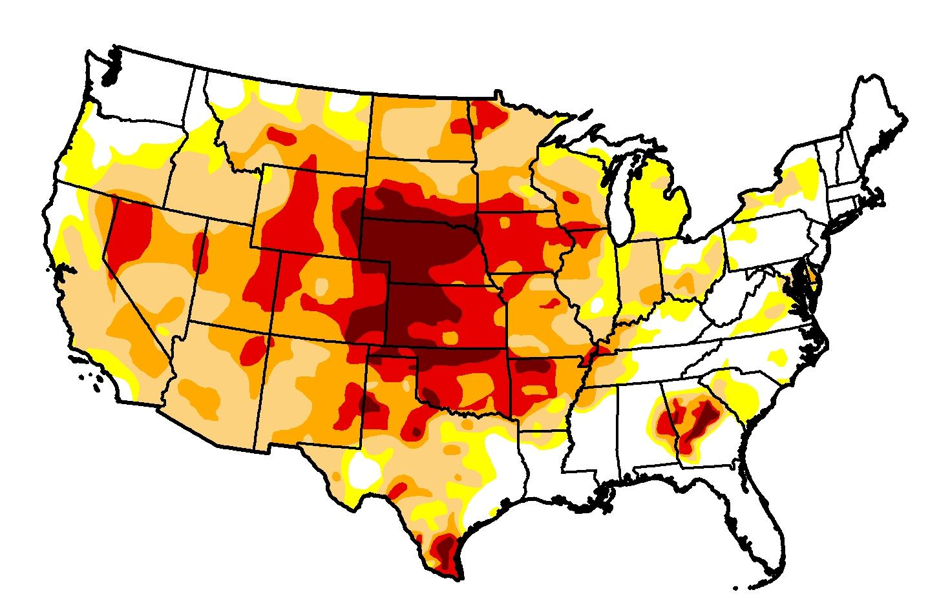
Oct 2,2012

Slide 28
What Happened Last Fall ?
# Colonies
Dead
% Operation Dead
State
Wisconsin 3,200 25
S Dakota 8,300 30
N Dakota 10,000 50
42,000 40
14,000 47
6,000 60
5,000 50
Montana 2,000 30
Arizona 1,500 30
California 2,500 35
4,100 65
3,300 33
4,600 42
Phone Survey conducted by Mann Lake Ltd October 2012

Slide 29
NASS 2012 Acreage Report
Corn 96.4 million highest acreage since 1937
Soybean 76.1 million record high acreage in NY, ND, SD* and Penn.
Cotton 12.6 million decrease of 14%

Slide 31
Almond Pollination 2013
January 31,2013 It’s too early to realize the full impact of the bee shortage this year.
I know several beekeepers who have lost 50% or more of their colonies.
Most Almond growers are looking for several hundred colonies
More than 300 trucks short (125,000 – 155,000 colonies)
There will be plenty of boxes this year QUALITY is the issue. A lot of 3-4 framers are going in as bee hives.
Some growers are cutting back from 3 hives/acre down to 2 hives/acre to have some bees on everything.
The train wreck will happen this summer if we do not have good weather in the Midwest.

Slide 32
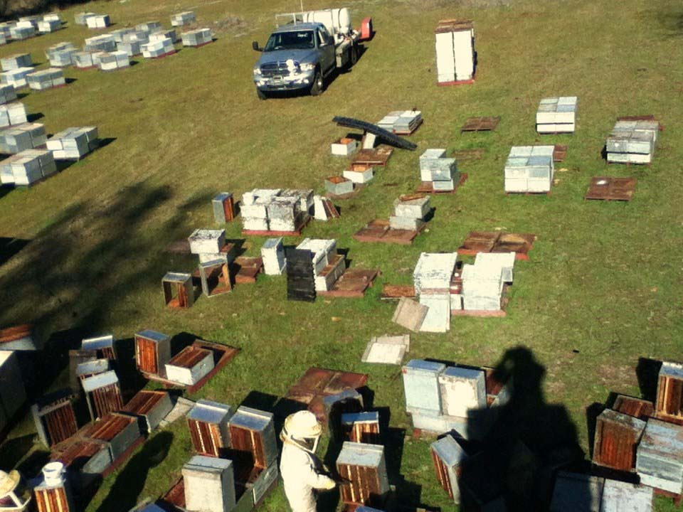
My operation started last spring with a high count of 3150 hives, today I have 992 alive, most in severely weakened condition …
- Jeff Anderson, Minnesota

